Slide 1
HEVC PROGRESSIVE DOWNLOAD TESTING
By Hammad Shafiq and Hassan Farooq

Slide 2
Introduction
Objective: Set up an HTTP server and test the progressive download of an HEVC-encoded video.

Slide 3
Key Tasks
Test browser compatibility and progressive download.
Document network behavior under throttling.
Analyze findings and provide conclusions.

Slide 4
Experimental Setup
HTTP Server
Hosted on localhost using VS code live server extension
Hosted on Vercel via Github(https://project-m3u8-html-player.vercel.app/)
Video File
A big bunny sample Video encoded using ffmpeg
(https://archive.org/download/BigBuckBunny_328)
avi file
Ffmpeg Command used:
ffmpeg -i BigBuckBunny.avi -t 10 -vf scale=1920:1080 -c:v libx265 -b:v 5M -f hls -hls_time 10 -hls_playlist_type vod -hls_segment_filename '1080p_%03d.ts' 1080p.m3u8
Network Testing
Throttling profiles: 3G, Slow 4G, Fast 4G

Slide 5
Ffmpeg Command
ffmpeg -i BigBuckBunny.avi: Inputs the video BigBuckBunny.avi.
-t 10: Limits the output to the first 10 seconds.
-vf scale=1920:1080: Resizes the video to 1080p resolution.
-c:v libx265: Uses H.265 codec for video encoding.
-b:v 5M: Sets video bitrate to 5 Mbps for quality.
-f hls: Outputs in HLS (HTTP Live Streaming) format.
-hls_time 10: Creates 10-second video segments.
-hls_playlist_type vod: Defines playlist as Video On Demand (VOD).
-hls_segment_filename '1080p_%03d.ts': Names video segments 1080p_001.ts, 1080p_002.ts, etc.
1080p.m3u8: Outputs HLS playlist as 1080p.m3u8.

Slide 6
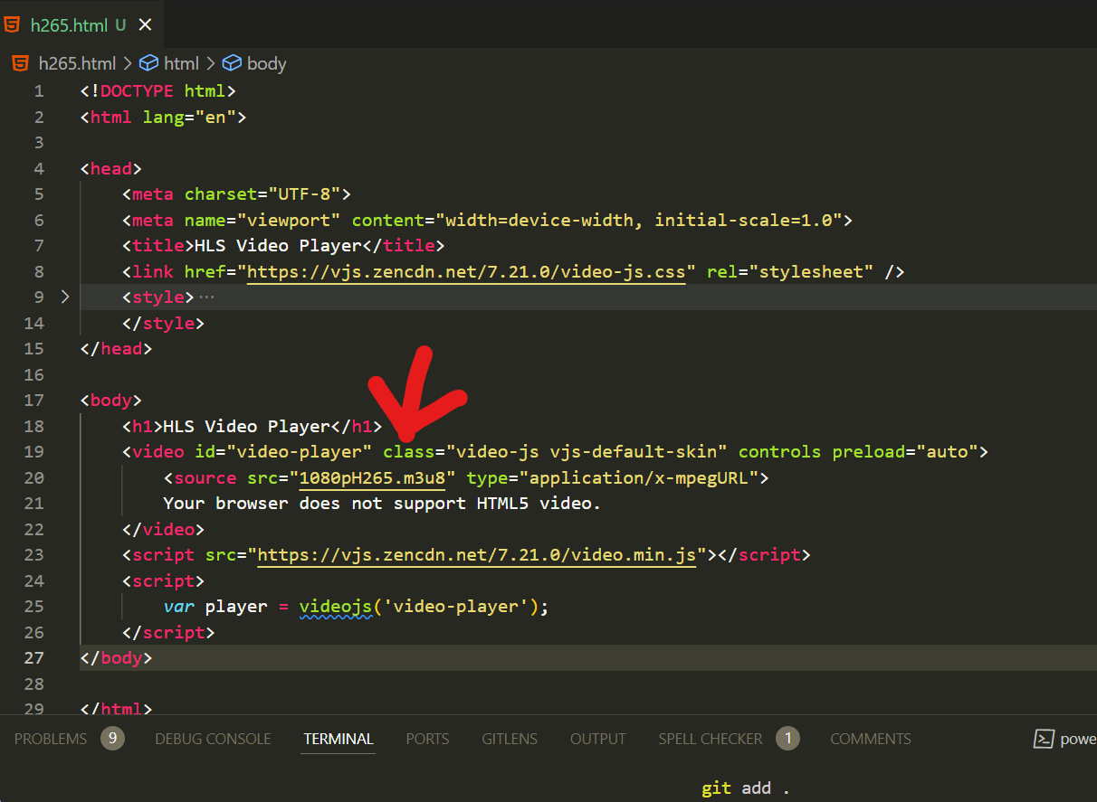
h265.html

Slide 7
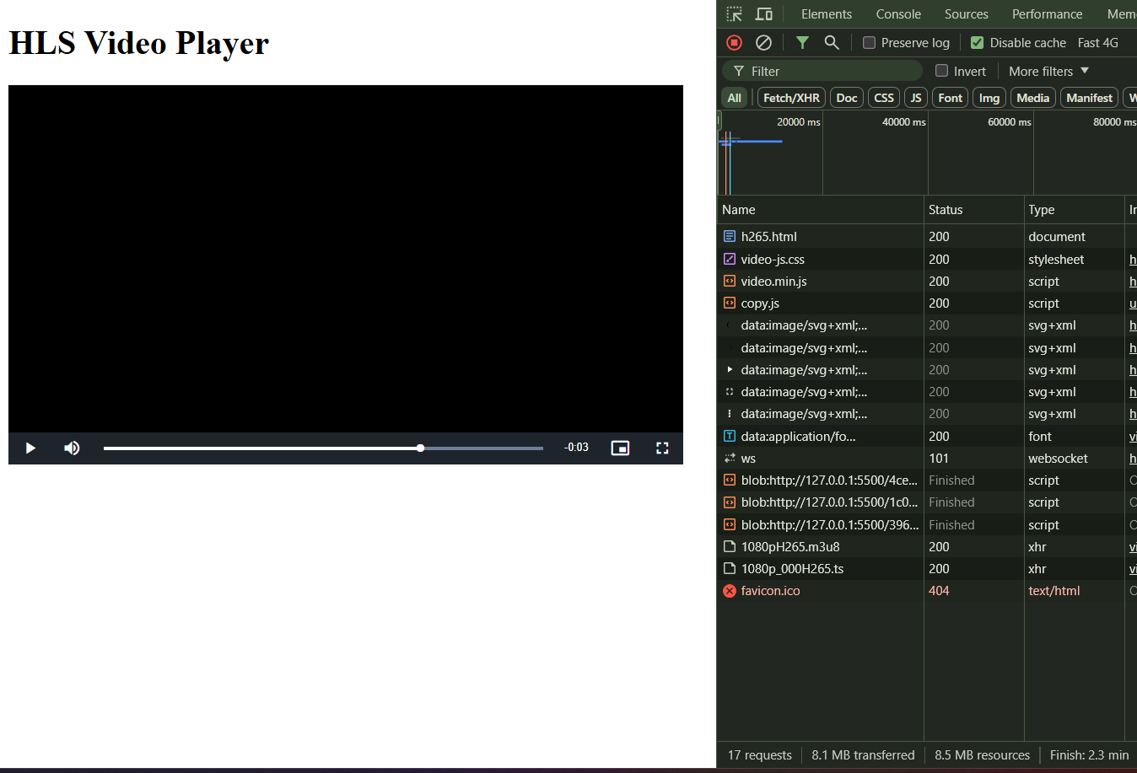
Output for H265

Slide 8
HEVC Browser Compatibility
HEVC video tested on
Google Chrome on Windows does not support H265.
Observations
Video played in VLC and Movies & TV app.
Browsers could not play the video due to HEVC limitations.
Conclusion: Video should be converted in H264.

Slide 9
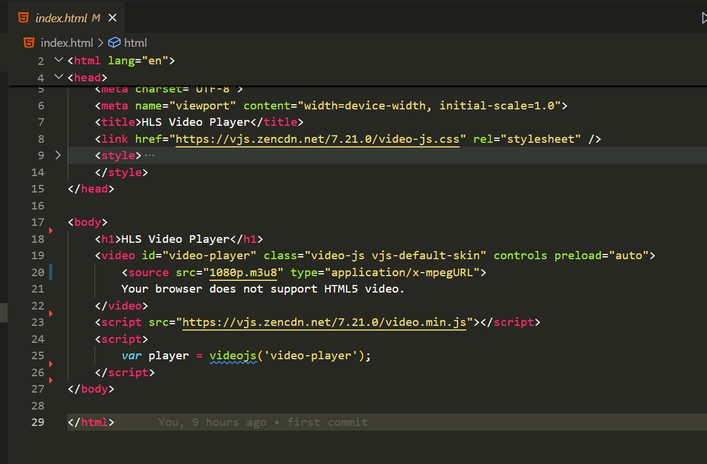
index.html for H264

Slide 10
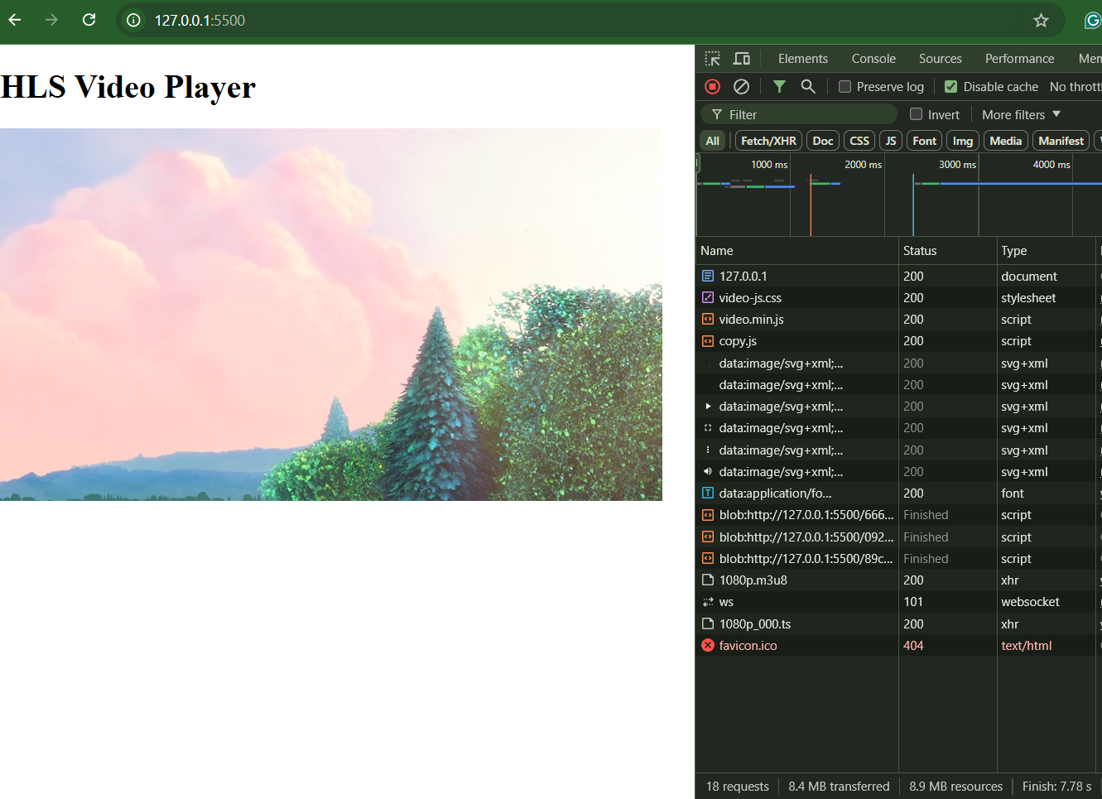
Output for H265

Slide 11
Comparison of Network Throttling H265
Profile | Time | Observations
3G | 2.9m | Significant delay due to limited bandwidth.
Slow 4G | 51.87 s | Faster but still noticeable delay.
Fast 4G | 13.08 s | Near-instantaneous loading compared to 3G.
No Throttling | 4.94 s | Very fast loading due to high bandwidth.

Slide 12
Vercel Link

Slide 13
Challenges and Observations
HEVC playback failed while testing due to limited support.
Throttling tests successfully simulated progressive download behavior: “Loading times improved significantly with better network profiles.”

Slide 14
Thank you

